Slide 1
Statistical Appendix to Support Climate Informed Public Finance Reviews
Proposal
March, 2024

Slide 2
Proposed approach
Suggested structure (this presentation)
Creating dataset and customizable charts to feed into Statistical Appendix building on Climate Scan
Case example

Slide 3
Proposed approach
Insights from IMF Article IV Summary Charts that support a “story line”
Organizing Statistical Appending based on core questions agreed upon by World Bank for Climate Informed PFR
Build on Climate Scan
Macro-fiscal analysis: Assess past performance and future trends / targets / scenarios
Green expenditure and revenue policies: Detailed description seeking to compare with financing needs and resulting fiscal impacts
Seeking for a common framework, but acknowledging country heterogeneity of climate impacts, policy

Slide 4
Proposed Structure Statistical Appendix

Slide 5
Statistical appendix akin to set of charts regularly included in IMF Article IV reports
Using charts and associated (short) comments to provide a narrative regarding climate elements that are relevant for Public Finance Reviews
Charts and narratives to be built on the basis of “core questions” identified for climate informed PFRs
Things to “borrow” from Article IV:
Article IV: Sector / PFR: Chapter
Narrative
Charts (PFRs borrowing from Climate Scan)

Slide 6
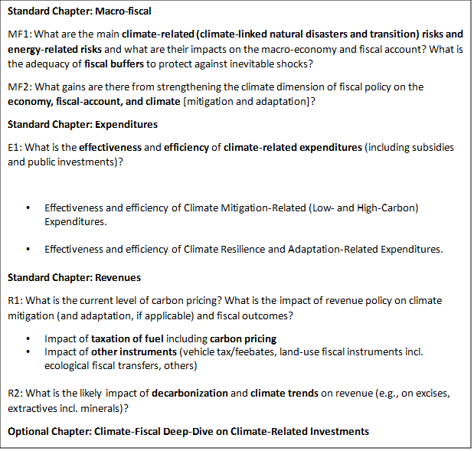
What’s the value of the Statistical appendix?
Organized building on the core climate questions that inform PFRs
Addressing climate considerations to macro fiscal analyses that are not sufficiently or adequately addressed by Country Climate and Development Reports
Seeking to provide a common framework for analyzing and describing macro-fiscal risks (and opportunities) from climate change
While acknowledging country-heterogeneity in assessing climate risks, impacts and candidate climate resilience and GHG mitigation policies

Slide 7
What are candidate topics to be included: Macro Fiscal Chapter
Past performance | Future: Targets / Trends / Estimates
Macro-fiscal performance | GDP targets
Climate related damages | Main climate related hazards
GHG emissions: Total, sectors | GHG Baseline estimates, NDCs, Net Zero target
Global contribution to emissions (large countries) | Cumulative GHG emissions (large countries)
Proximate sources of emissions: Kaya decomposition | Kaya decomposition exercise: Target GDP growth
Carbon intensity: Trends, drivers, benchmark analysis | Carbon intensity scenario: Benchmark analysis
Energy intensity: Trends, drivers, benchmark analysis | Energy intensity scenario: Benchmark analysis
Production and consumption GHG emissions | Impacts of CBAM on trade (e.g from modeling)
Key sectors description: Energy (Transportation, Power Generation), Agriculture and land, Waste, IPPU | Sector targets description: Energy, Agriculture and land, Waste, IPPU
Risk factors: Exposure, vulnerability | Emerging risk factors: Trends
Transitional issues: Cohorts, sectors, stranded assets | Emerging transitional issues: e.g. CBAM
Fiscal buffers: Fiscal space, climate disaster funds | Green financing

Slide 8
What are candidate topics to be included: Expenditure, Revenue Chapters
Expenditures | Revenues
Green expenditures in energy (e.g. power generation capacity, by technology) | Environmental tax revenues
Subsidies (Renewable Energy, Fossil Fuels) | Carbon market-based mechanisms
Other green expenditures in GHG mitigation related sectors (e.g. LULUCh, Agriculture, Waste, IPPU) | Selected fees (e.g passenger vehicles, by type; pollutants)
Climate resilience expenditures | Potential revenue generation and GHG emissions from revenue policy (e.g. CPAT)
Financing needs
GHG mitigation and climate resilience financing needs (Total, by sectors)
Investment needs by stakeholder (public, private sector)
Contribution of multilateral, bilateral foreign sources of financing
Fiscal gap, impacts (e.g. fiscal balance, debt dynamics, from modeling)

Slide 9
Example: Peru

Slide 10
Macro-Fiscal: GDP and GHG emissions
Peru has been able to sustain real per capita growth rates of nearly 3.5% over 2 decades…
But at a cost of rising GHG emission and environmental degradation…

Slide 11
Macro-Fiscal: Proximate sources of GHG emission growth (Kaya decomposition)
The country has not been able to decouple economic activity from GHG emissions even though there is variability in GHG intensity….
…caused by changes in carbon intensity (the ratio of GHG to energy demand) and energy intensity (the ratio of energy demand to GDP).

Slide 12
Macro-Fiscal: Sources of GHG emissions
Over the last 2 decades, more than half of Peru’s GHG emissions are the result of land use and land use changes, from deforestation and land degradation associated to economic activity. Energy contributes a third of total emissions…
…and with carbon dioxide contributing with three quarters of total GHG. Transport sector contributed with nearly 37% of total GHG emissions, followed by energy industries (electricity generation, oil refining, fossil fuel production) with 29%.

Slide 13
Macro-Fiscal: Carbon and Energy Intensity
Peru has moderately succeeded in reducing carbon intensity and energy intensity….
…with carbon intensity improving at a rate of 1.5% per year over the last 2 decades, and energy intensity at 1.3% over the same period

Slide 14
Macro-Fiscal: Carbon and Energy Intensity. Benchmark analysis
Comparatively Peru’s carbon intensity is similar to that of Latin American countries best performers, and not far from that of developed countries…
…Similarly, Peru is among top performer in energy intensity compared to Latin American peers and not far from developed countries

Slide 15
Macro-Fiscal: Climate risks
Peru is improving adaptation capabilities to climate related hazards, mainly from enhanced readiness given improved economic economic, social and governance performance. But it remains vulnerable to climate impacts…
…despite improved adaptation, the country still lags among Latin American countries. Sources of vulnerability include water, ecosystem, food and health sectors

Slide 16
Macro-Fiscal: Targets
Peru’s NDC include an unconditional target of 208.8 MM TonCo2e by 2030, effectively keeping them constant relative to 2021. Conditional NDCs of 179 MM TonCO2e imply a nearly 2% decrease over the rest of the decade….
For moderate scenarios for per capita GDP growth (1.6% per year) and expected population growth rates (1.3% per year), attaining Unconditional and Conditional NDCs requires a combined improvement of energy intensity and carbon intensity of 3.0% and 5.0% through 2030.

Slide 17
Expenditures (1)
Lack of further progress in carbon intensity reduction resides in the continued dependency on fossil fuels for energy generation…
…Although the country has scaled up its green effort by boosting public investments in renewable energy sources, including hydro, solar and wind.

Slide 18
Expenditures (2)
Peru has reduced implicit subsidies over fossil fuels, sending price signals for a shift to low carbon sources of energy….
…Fossil Fuel Subsidies are on the lower end among Latin American countries

Slide 19
Revenues (1)
Peru lags behind Latin American peers in terms of environmental taxation…..
[CPAT]

